Slide 1
CIS 4930-001: Introduction to Augmented and Virtual Reality
Depth and Projection

Slide 2
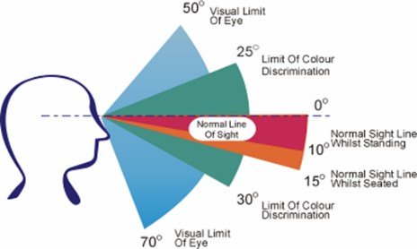
Human Horizontal and Vertical FOV
See up to ~ 210º horizontal FOV, ~ 115º stereo overlap
Humans can see ~135º vertical (60º above, 75º below)

Slide 3
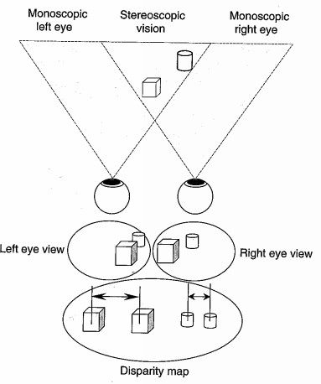

Slide 4
How do we really see depth?

Slide 5
Depth Perception
The visual system uses a range of different Stereoscopic and Monocular cues for depth perception
Parallax can be more important for depth perception! Stereoscopy is important for size and distance evaluation
Stereoscopic | Monocular
eye convergence angle | eye accommodation
disparity between R/L images | perspective
diplopia | atmospheric artifacts (fog)
 | relative sizes
 | image blur
 | occlusion
 | motion parallax
 | shadows
 | texture

Slide 6
Perspective
Objects get smaller the further away they are and parallel line converge in distance.

Slide 7
Size of known objects
We expect certain object to be smaller than others. If an elephant and a tea cup appear the same size then we expect the elephant to be further away.

Slide 8
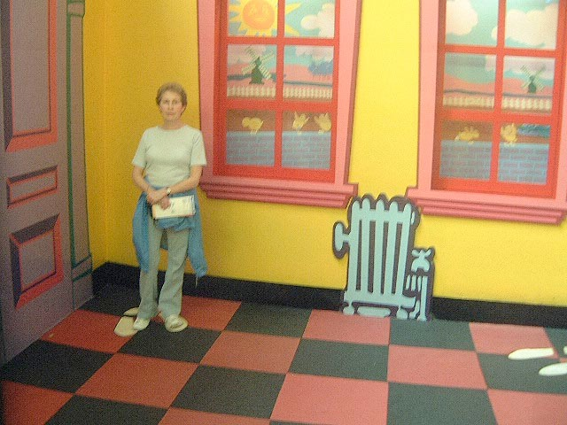
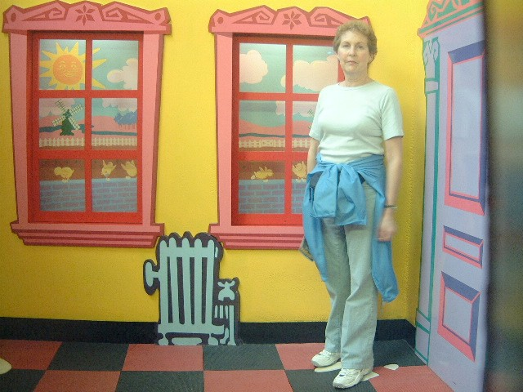
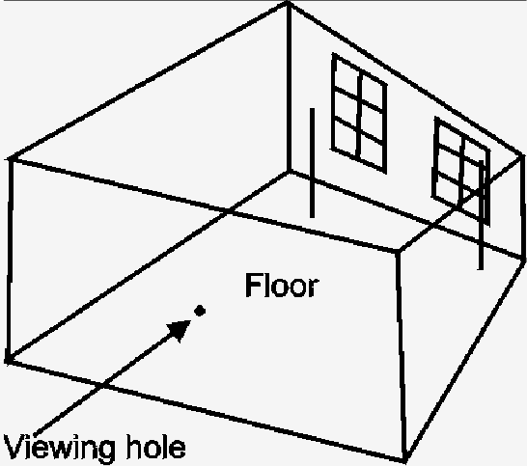
Ames Room (Optical Illusion Based on Known Object Size)

Slide 9
Detail
Close objects appear in more detail, distant objects less.

Slide 10
Occlusion
An object that blocks another is assumed to be in the foreground.

Slide 11
Lighting, shadows
Closer objects are brighter, distant ones dimmer.
There are a number of other more subtle cues implied by lighting
The way a curved surface reflects light suggests the rate of curvature
Shadows are a form of occlusion

Slide 12
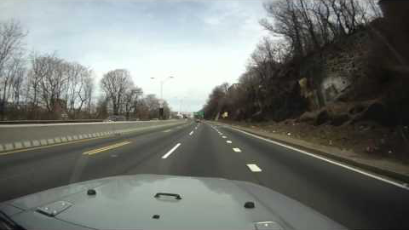
Relative motion/Motion parallax
Objects further away seem to move more slowly than objects in the foreground.
https://youtu.be/u9ItKCdDKt0?t=11787

Slide 13
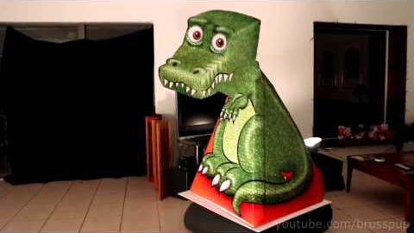
Optical Illusion
https://youtu.be/5cJRe9iDDjs

Slide 14
Stereo Viewing - Depth cues 3D only
There are other cues that are not present in 2D images

Slide 15
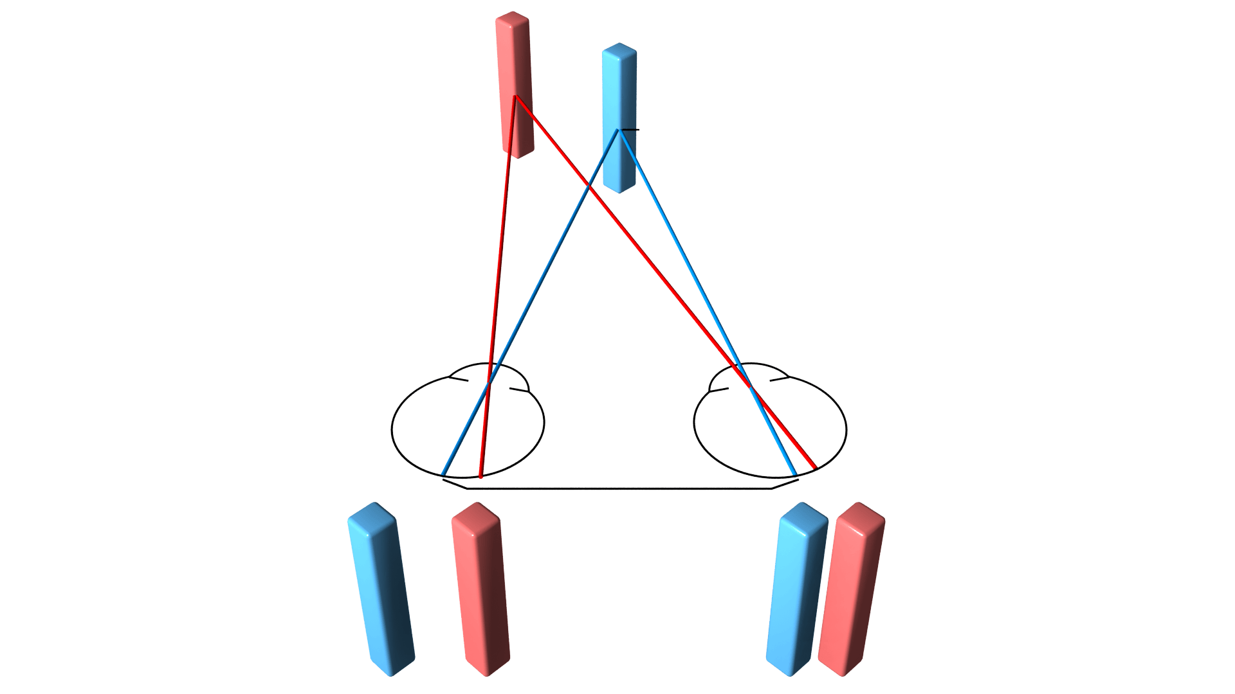
Binocular disparity (Stereopsis)
This is the difference in the images projected onto the back the eye (and then onto the visual cortex) because the eyes are separated horizontally by the intraocular distance (distance between the eyes).
Eyes separated by Inter pupillary distance (IPD)
5 – 7.5cm (avg. 6.5cm)
Each eye sees diff. image
Separated by image parallax
Images fused to create 3D stereo view
Accuracy
0.05mm @ ½m (0.01% error)
4mm @ 5m (0.08% error)

Slide 16
Convergence
This is the muscle tension required to rotate each eye so that it is facing the focal point.

Slide 17
Accommodation
This is the muscle tension needed to change the focal length of the eye lens in order to focus at a particular depth.

Slide 18
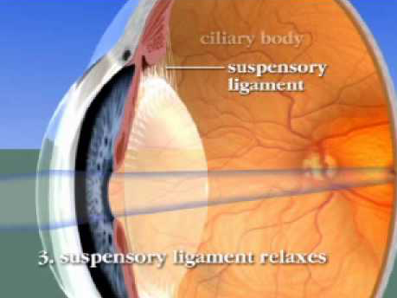
Convergence/Accommodation Demo
https://youtu.be/p_xLO7yxgOk

Slide 19
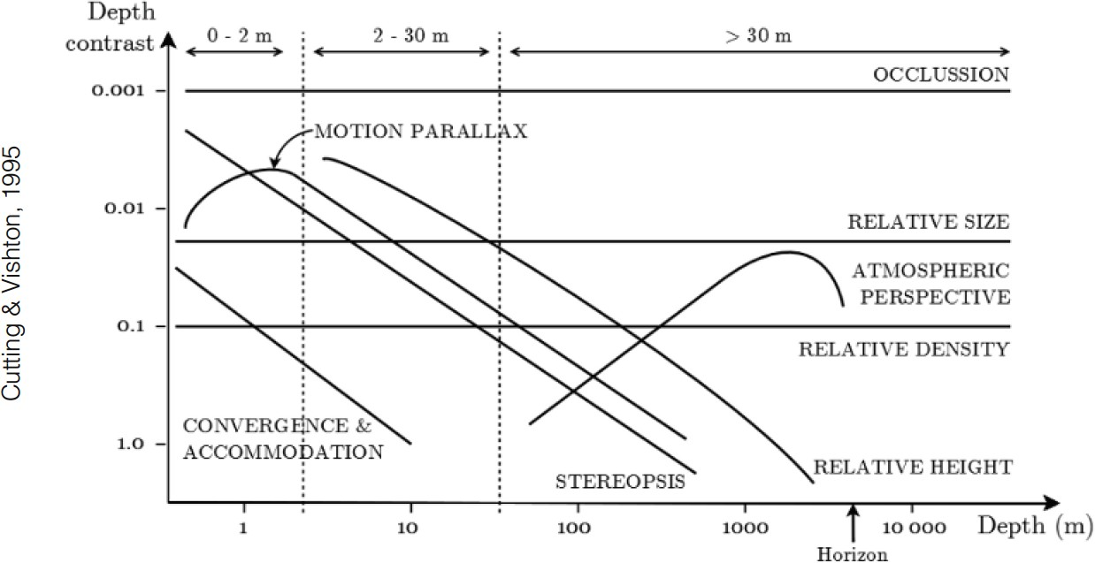
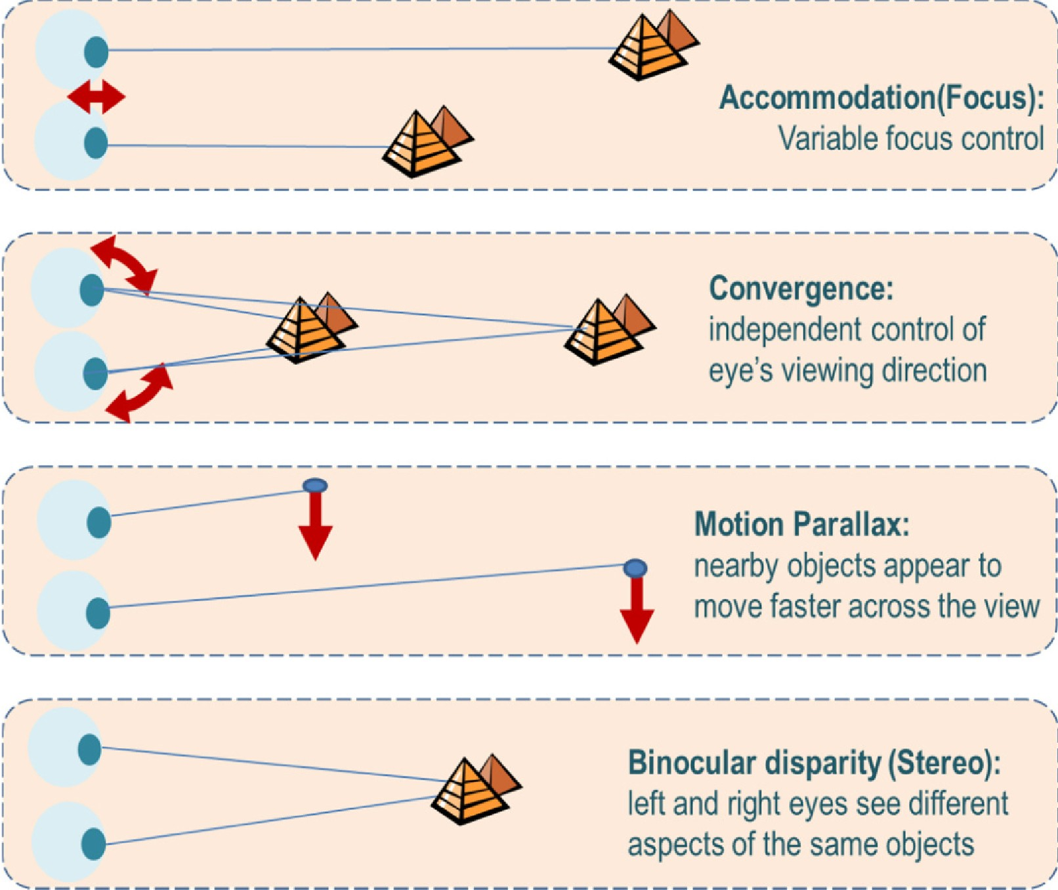
Depth Perception Distances

Slide 20
Stereo Viewing - Depth cues
Binocular disparity is considered the dominant depth cue for most people.
Other cues, if presented incorrectly can have a negative impact on the stereo effect
One cue can become dominant, may not be the correct one
Depth perception can become exaggerated or reduced, can be uncomfortable to watch
Or the stereo pairs will not be fused at all, viewer will see two separate images.

Slide 21
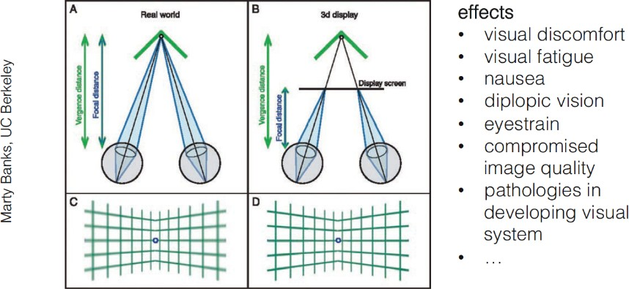
Convergence-Accommodation Conflict
Looking at real objects, convergence and focal distance match
In VR, convergence and accommodation can miss-match
Focusing on HMD screen, but accommodating for virtual object behind screen

Slide 22

Problems
Three categories for simulator sickness.
Proposed by Jason Herald
System factors
Latency, resolution, etc
Application Design Factors
Depth issues, overlapping, large movements
Individual User factors
Gender (next slide)
Visual impairments, biological differences (e.g., eye distance), training effects, etc.

Slide 23
Is there a Gender bias in VR?
Apparently, females use different depth queues than males—biological differences or not?
http://qz.com/192874/is-the-oculus-rift-designed-to-be-sexist/
Summary: women appear to use lighting and shadow more strongly than men
Requires more research
In Stanney et al. 2014, females are as much as three times more susceptible to VR sickness than males in some cases.

Slide 24
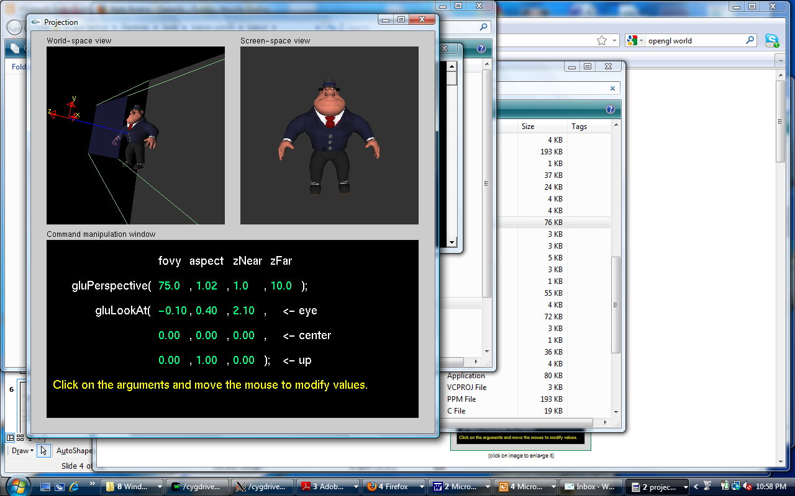
Generating Computer Images
Specify the location/parameters of camera (this slide deck)
derivation of projections and transformations
Specify the geometry (next slide deck)
Specify the lights (2 slide decks from now)
We’re going to talk about this in the context of generic OpenGL. Other platforms (e.g. DirectX) treat things similarly.

Slide 25
OpenGL
OpenGL is a graphics API, nothing more than a set of functions you call from your program
Most functions map directly to GPU hardware functionality
Hides the details of the display adapter, operating system, etc.
Has grown to become a powerful/flexible general purpose compute platform

Slide 26
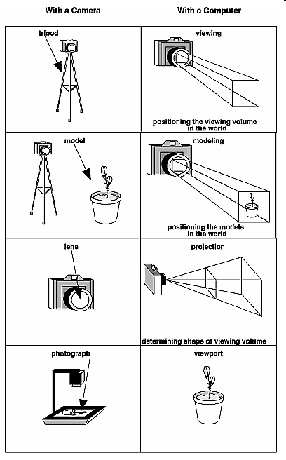
The Camera Analogy

Slide 27
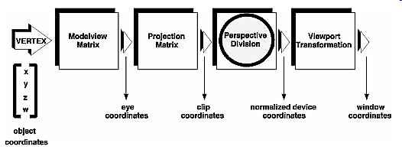
Basic Vertex Pipeline
Entire pipeline handled by a series of 4x4 matrix multiplications*

Slide 28
OpenGL: Camera
Three things to specify:
Projection properties of the camera (Projection)
Depth of field?
Field of view in the x and y directions?
Physical location of camera in the scene (ModelView)
Where is the camera?
Which direction is it pointing?
What is the orientation of the camera?
Physical location of objects in the scene (ModelView)
Where are objects?
What orientation do they have?

Slide 29
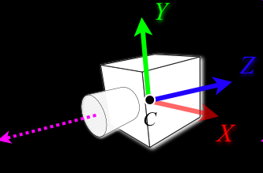
The OpenGL Camera
Initially the object and camera frames are the same:
Default model-view matrix is identity
Default projection matrix is identity
The camera is located at origin and points in the negative z direction

Slide 30

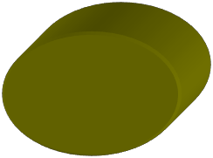


Standard 3D graphics Projection
Field of View
(FOV)
Projection
plane
Camera
View frustum.
Camera
Back clipping
plane
Front clipping
plane
Scene

Slide 31
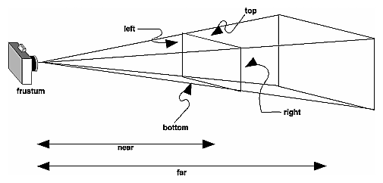
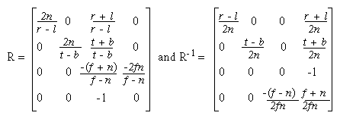
Perspective Projection
glFrustum(l, r, b, t, n, f)

Slide 32
Camera Positioning
Handled via the ModelView matrix
View mostly controlled with
Look at function
Model mostly controlled using (camera too):
Translation
Rotation
Scaling

Slide 33
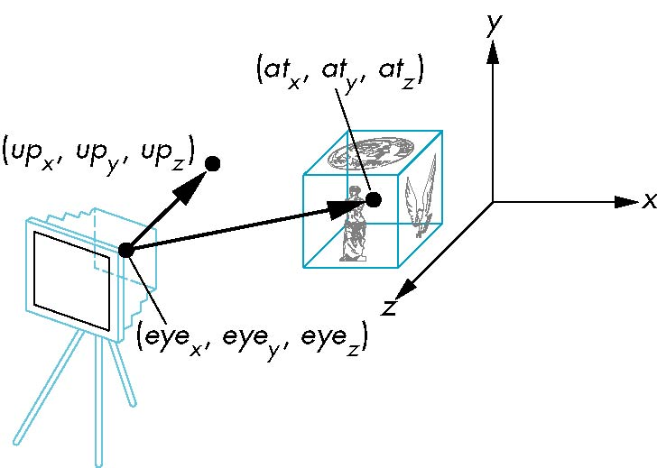
Look At Functions
Establish a coordinate system by specifying an eye position (eyex,eyey,eyez); a target location (atx,aty,atz); and an up vector (upx,upy,upz)
For a proper coordinate system, up vector should be orthogonal to the view vector (at-eye).
gluLookAt(eyex, eyey, eyez, atx, aty, atz, upx, upy, upz)

Slide 34
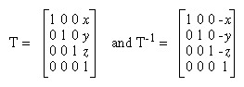
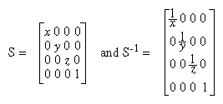
OpenGL uses a column-major Matrices
glTranslate*(x, y, z)
glScale*(x, y, z)

Slide 35
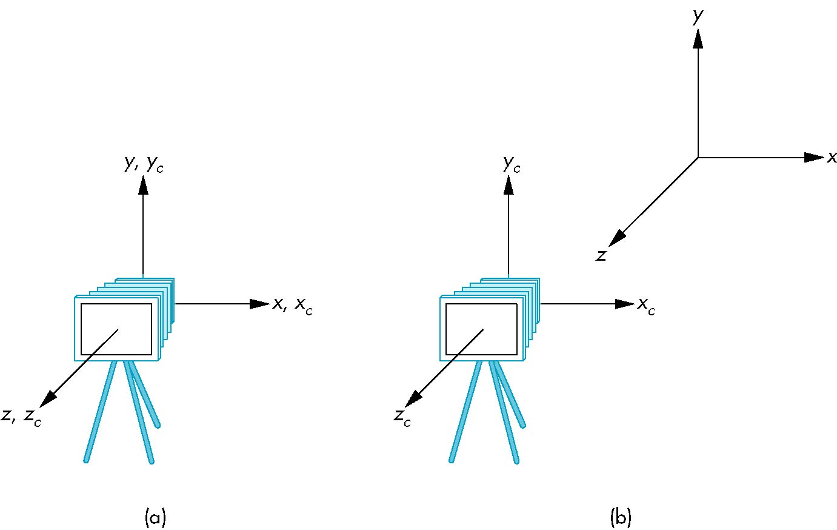
Moving Camera Back
frames after translation by –d
d > 0
default frames

Slide 36
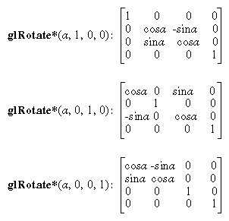
Rotations

Slide 37
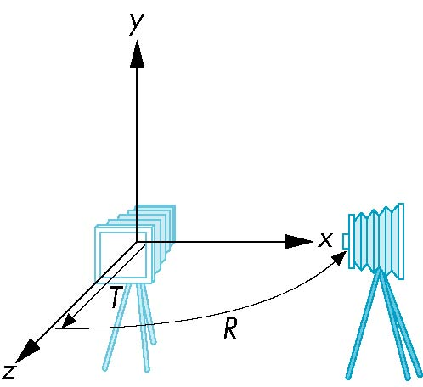
Moving the Camera
We can move the camera to any desired position by a sequence of rotations and translations
Example: side view
Rotate the camera
Move it away from origin
Model-view matrix C = RT

Slide 38
Quaternions
Extension of imaginary numbers to three dimensions
Requires one real and three imaginary components i, j, k
Quaternions can express rotations on sphere smoothly and efficiently.
Process:
Model-view matrix → quaternion
Carry out operations with quaternions
Quaternion → Model-view matrix
q=q₀+q₁i+q₂j+q₃k

Slide 39
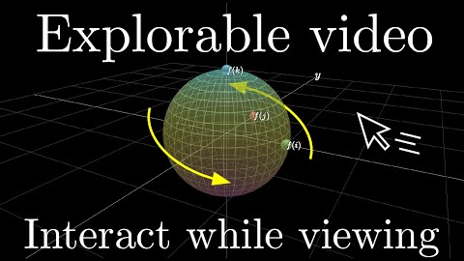
Why Quaternoins
https://youtu.be/zjMuIxRvygQ

Slide 40
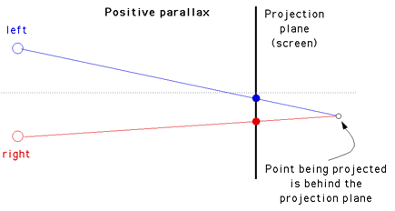
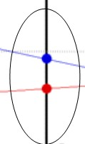
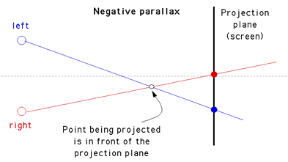
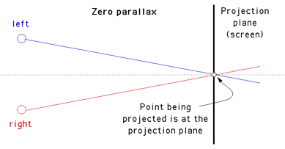
Parallax
Parallax, the distance between right and left eye projections.
Negative Parallax—Objects infront of projection plane
Positive Parallax—Objects behind projection plane
As objects moves closer to the viewer, the horizontal Parallax increases to infinity.
The maximum Parallax is reached when objects are at infinity, Parallax == interocular distance
Parallax

Slide 41
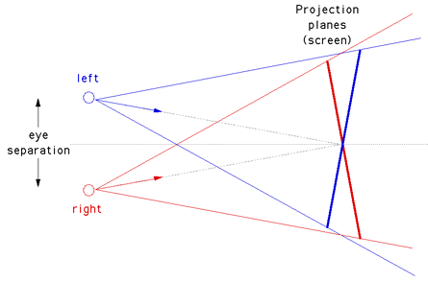
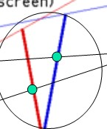


Rendering Stereo - Toe-in (Incorrect)
The camera has a fixed and symmetric aperture (frustum)
Each camera is pointed at a single focal point.
Images will still appear stereoscopic but introduces a vertical parallax that will cause increased discomfort levels.
The introduced vertical parallax increases out from the center of the projection plane and is more important as the camera aperture increases (FOV).
Vertical Parallax

Slide 42
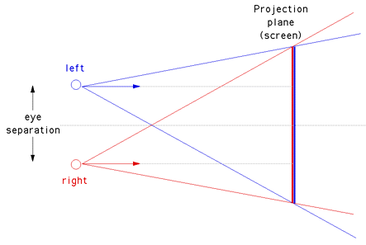
Rendering Stereo - Off-axis (Correct)
This is the correct way to create stereo pairs.
It introduces no vertical parallax and is therefore creates the less stressful stereo pairs.
Note that it requires a non symmetric camera frustum, which is supported by most rendering packages, including OpenGL
Projections of the point are both on a single vertical line == No vertical parallax

Slide 43

http://www.invectorize.com

